Slide 1
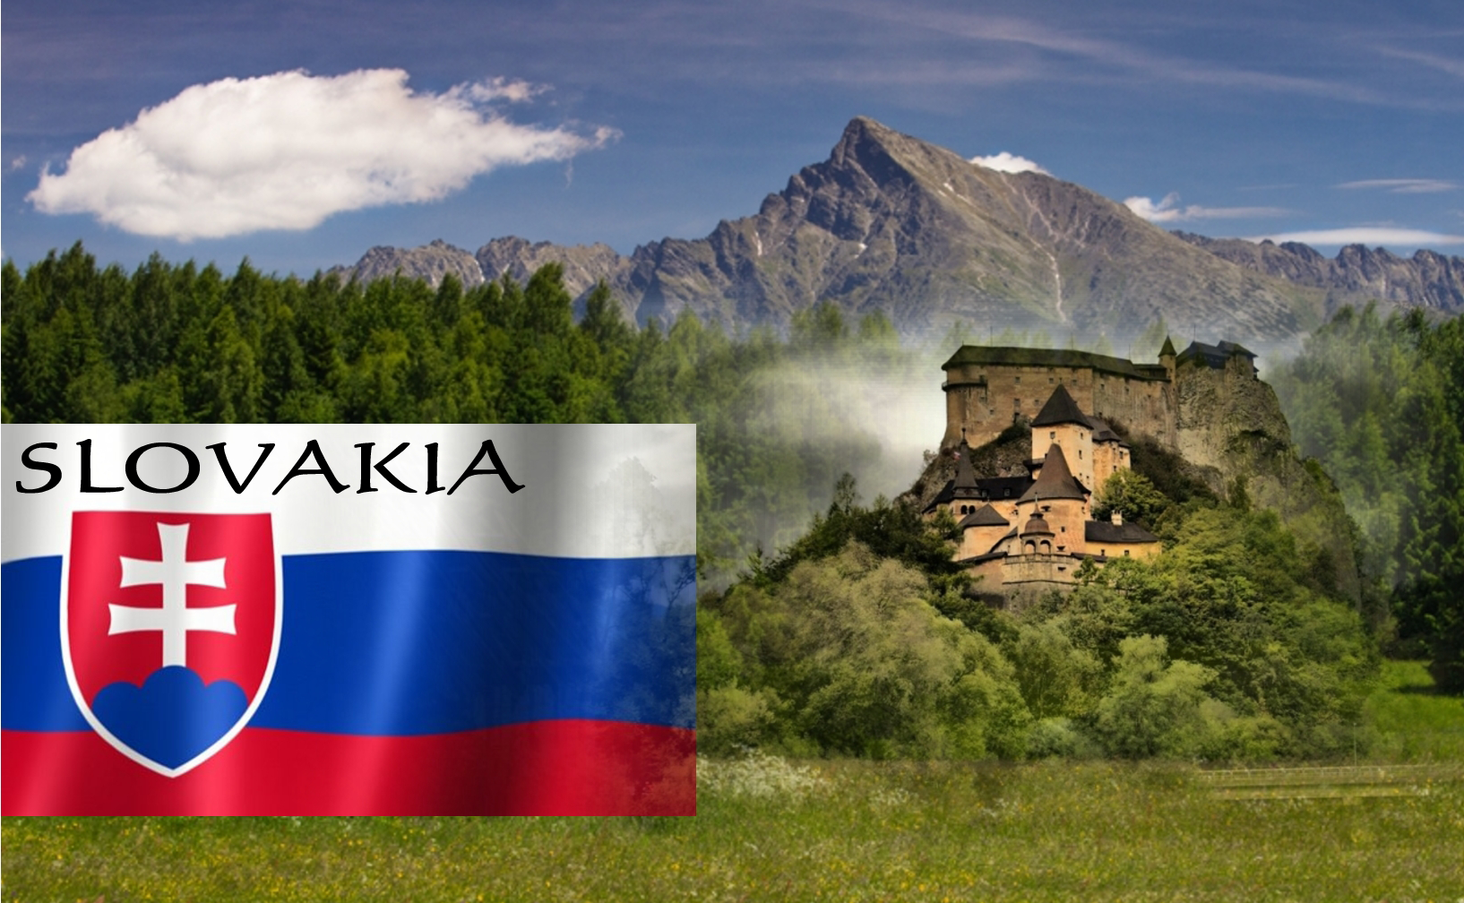

Slide 2
Ahoj
Dobrý deň
Ako sa voláš?

Slide 3
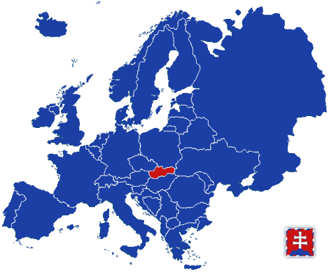
Slovakia in Europe

Slide 4
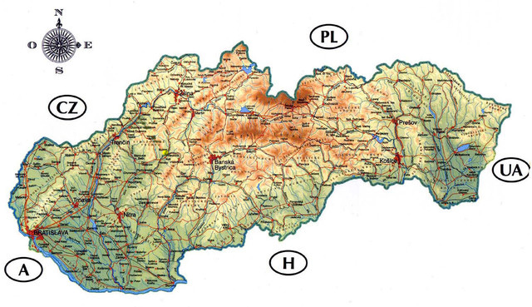
Oravská Jasenica

Slide 5
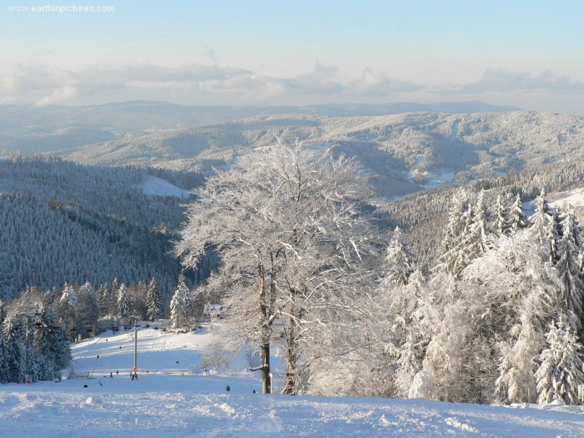
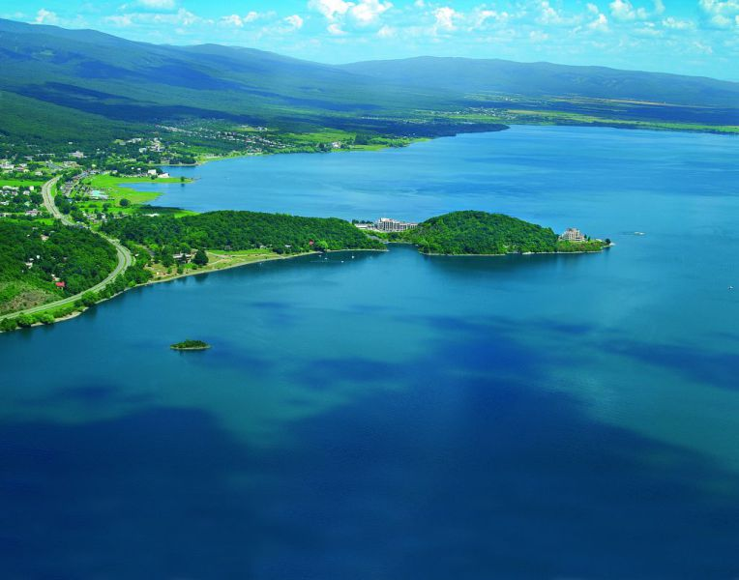
Climate and weather in Slovakia
Climate in Slovakia is continental with mild summer and winter temperatures, snow and rain, sun and wind.
Ski center Veľká Rača
Zemplínska Šírava

Slide 6
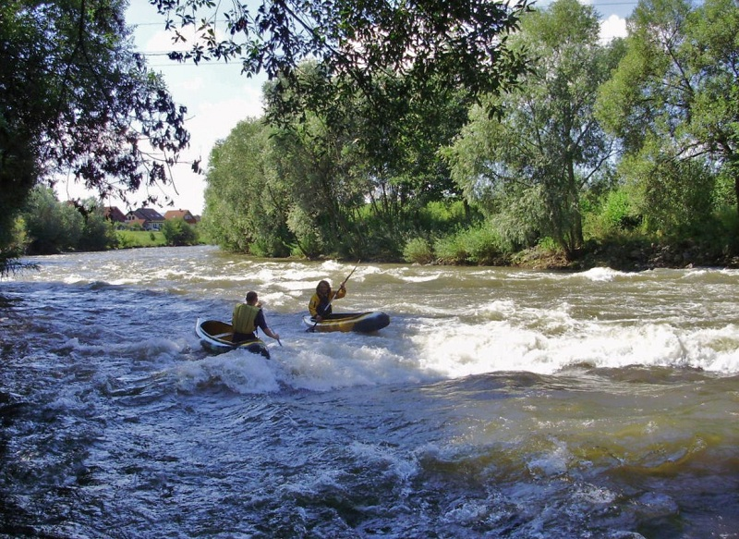
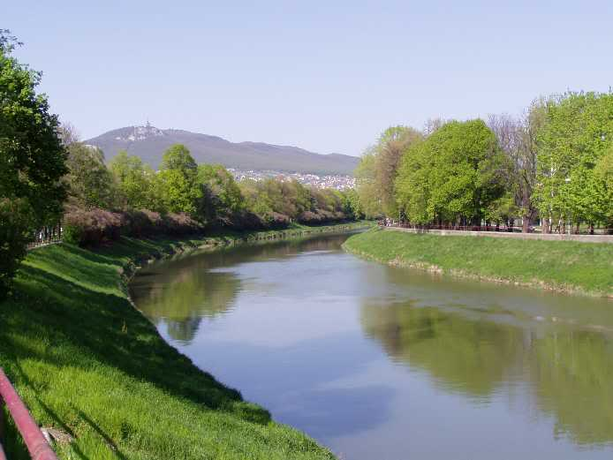
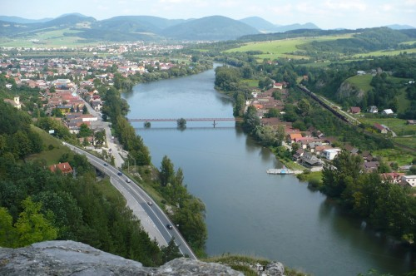
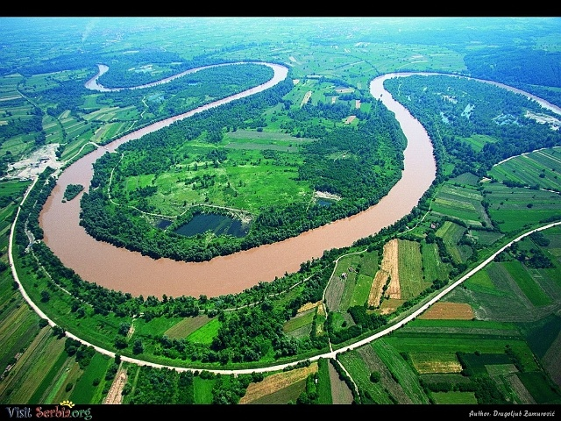
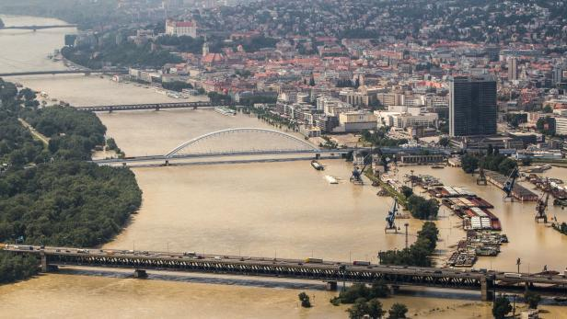
Rivers
Slovak rivers flow mainly to the Black and Baltic Sea watersheds. The most important are: Dunaj, Morava, Váh, Nitra, Hron ...

Slide 7
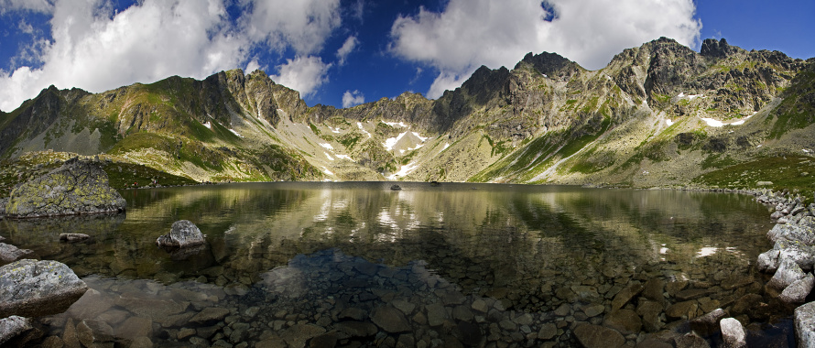
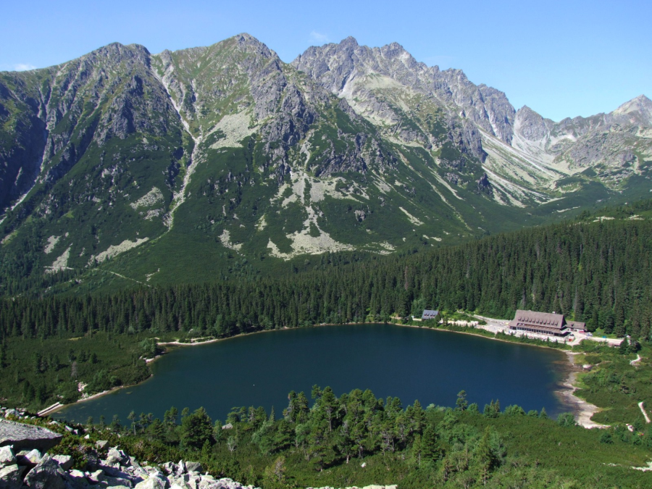
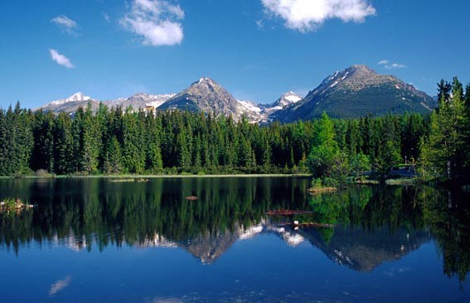
Lakes
Veľké Hincovo pleso
Popradské pleso
Štrbské pleso

Slide 8
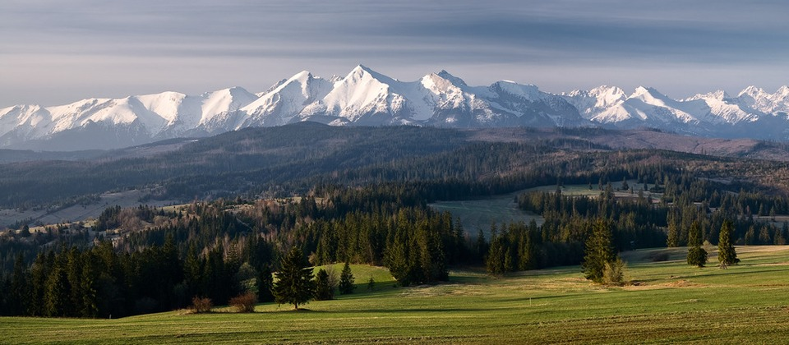
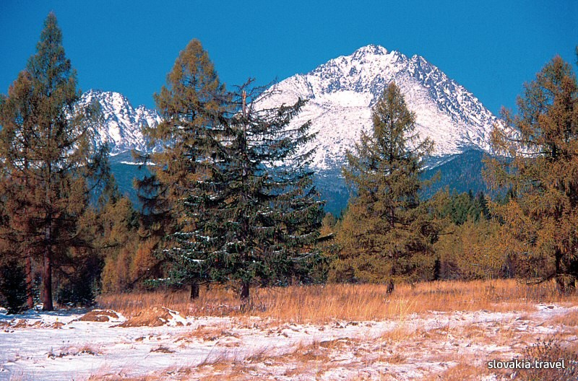
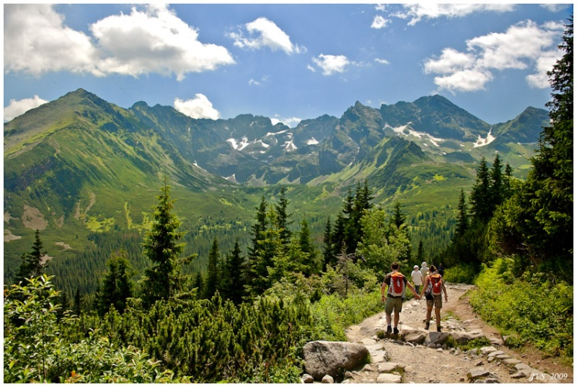
Geomorphological division of Slovakia
Slovakia belongs to the Alps- Himalaya system and to the sub-systems of the Carpathian mountains and of the Panonian basin.
Tatry
Gerlachovský štít (2655 m n. m.)

Slide 9
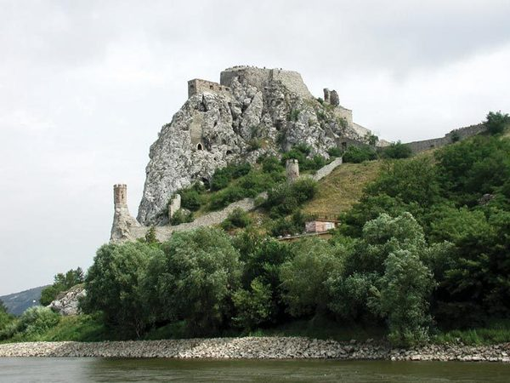
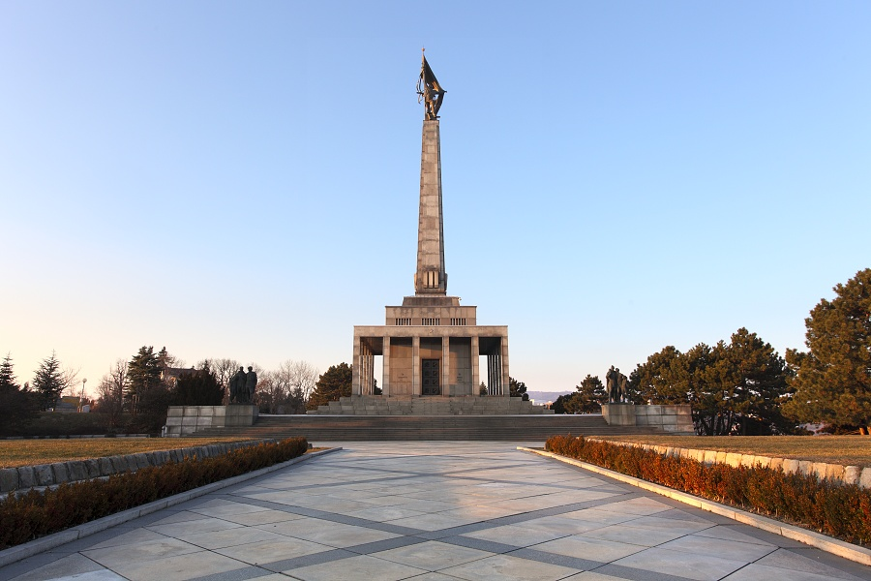
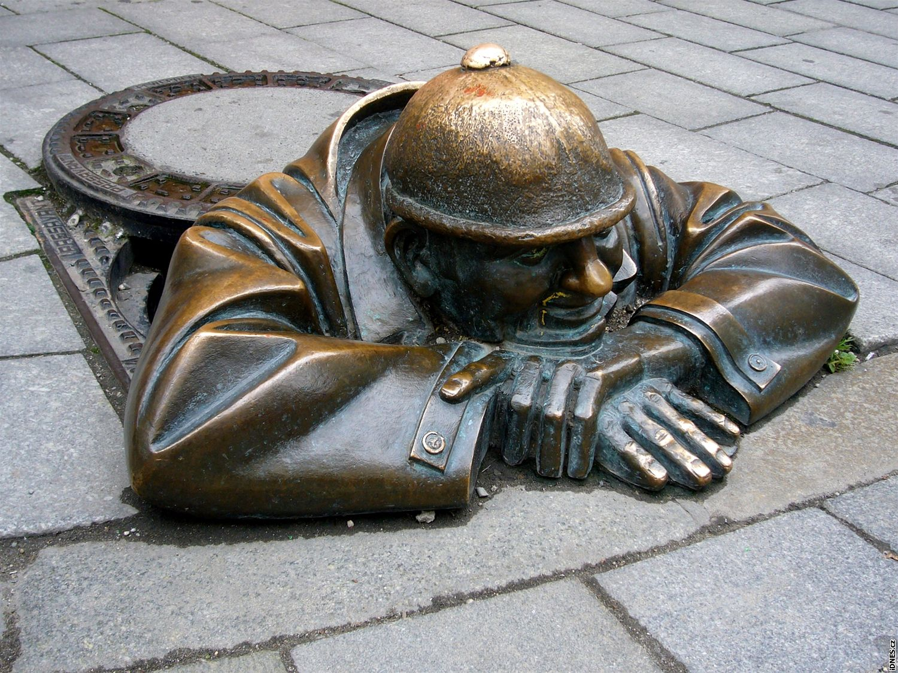
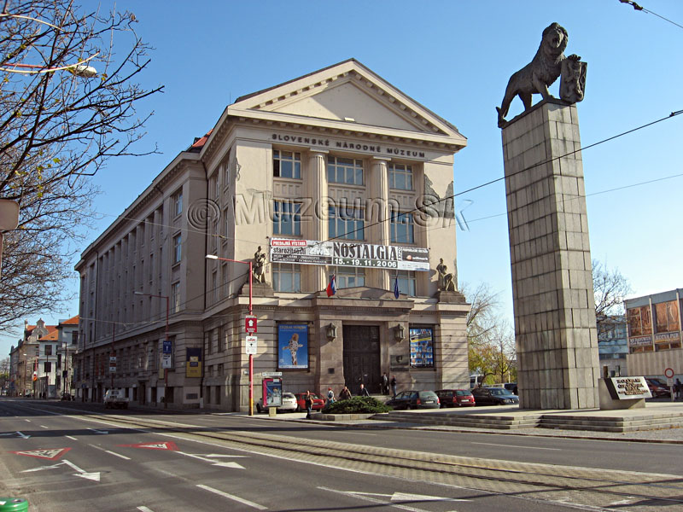
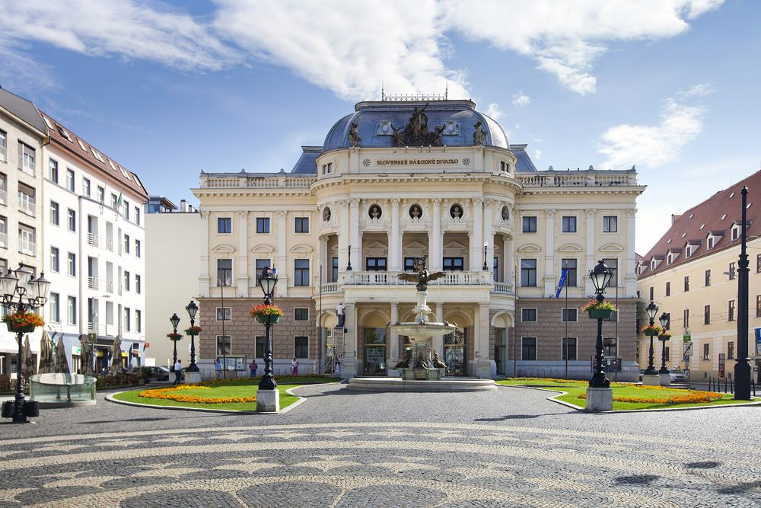
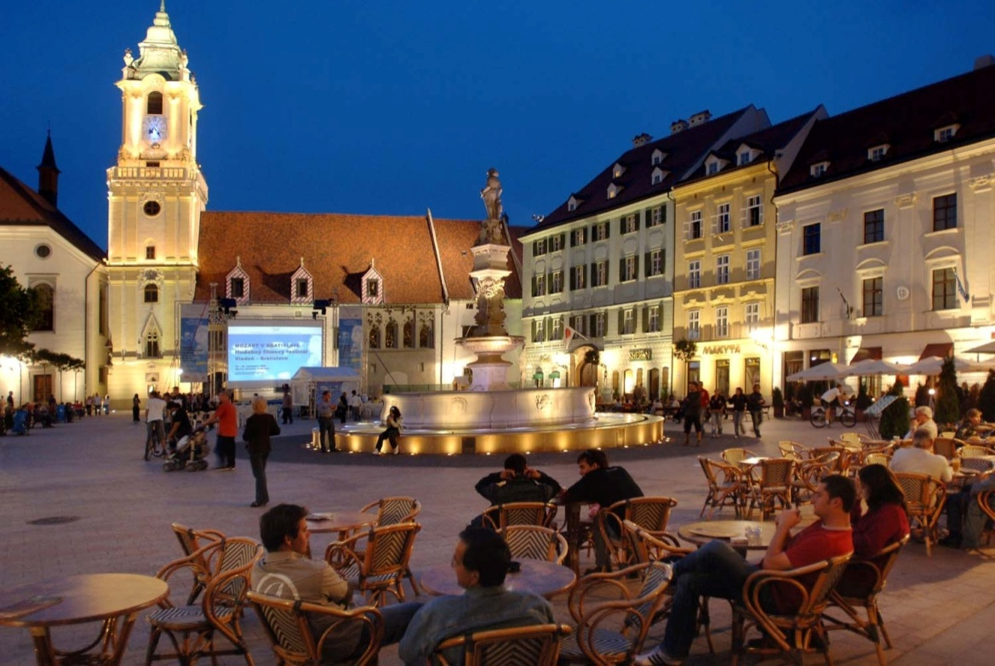
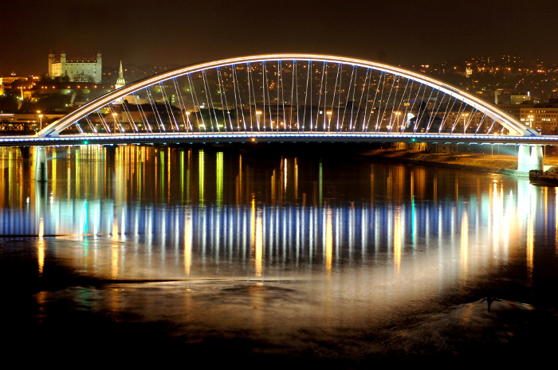
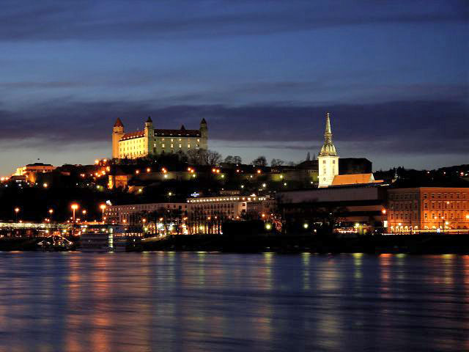
Bratislava –the capital of Slovakia

Slide 10
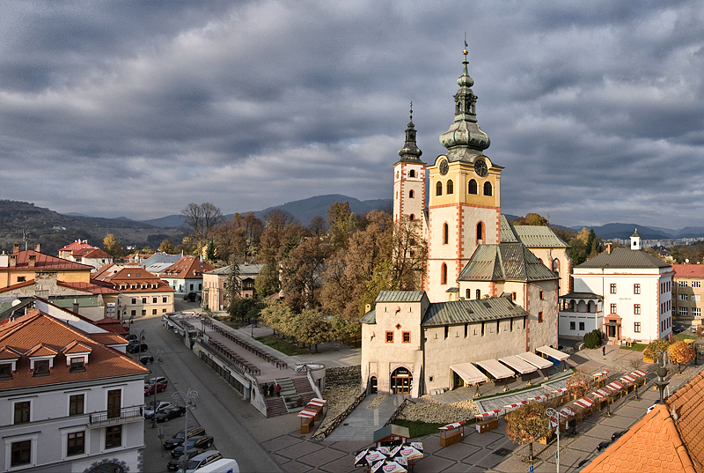
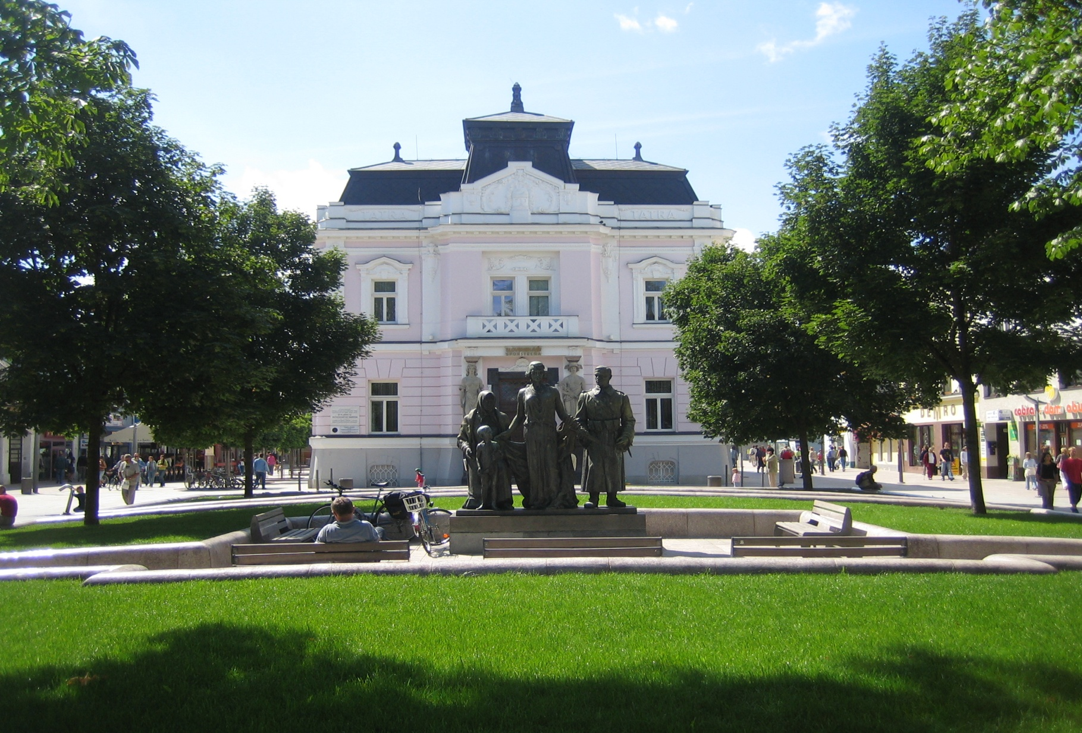
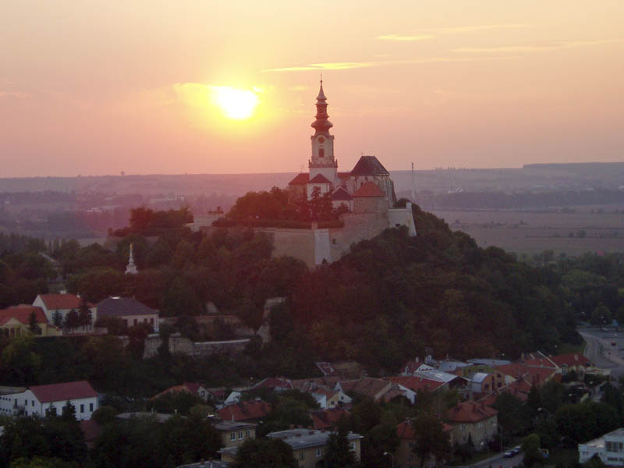
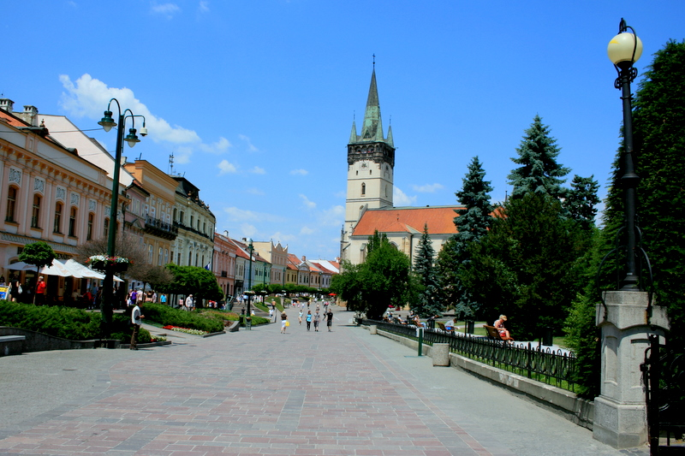
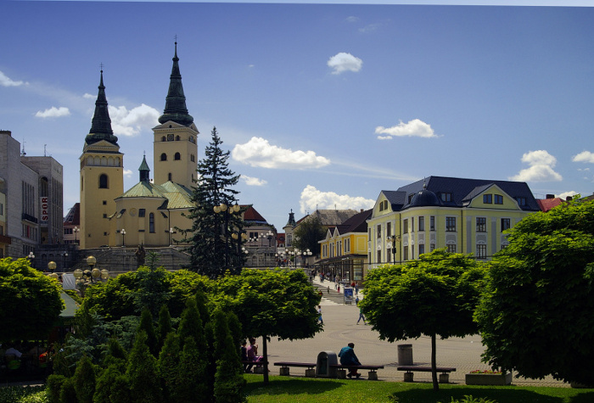
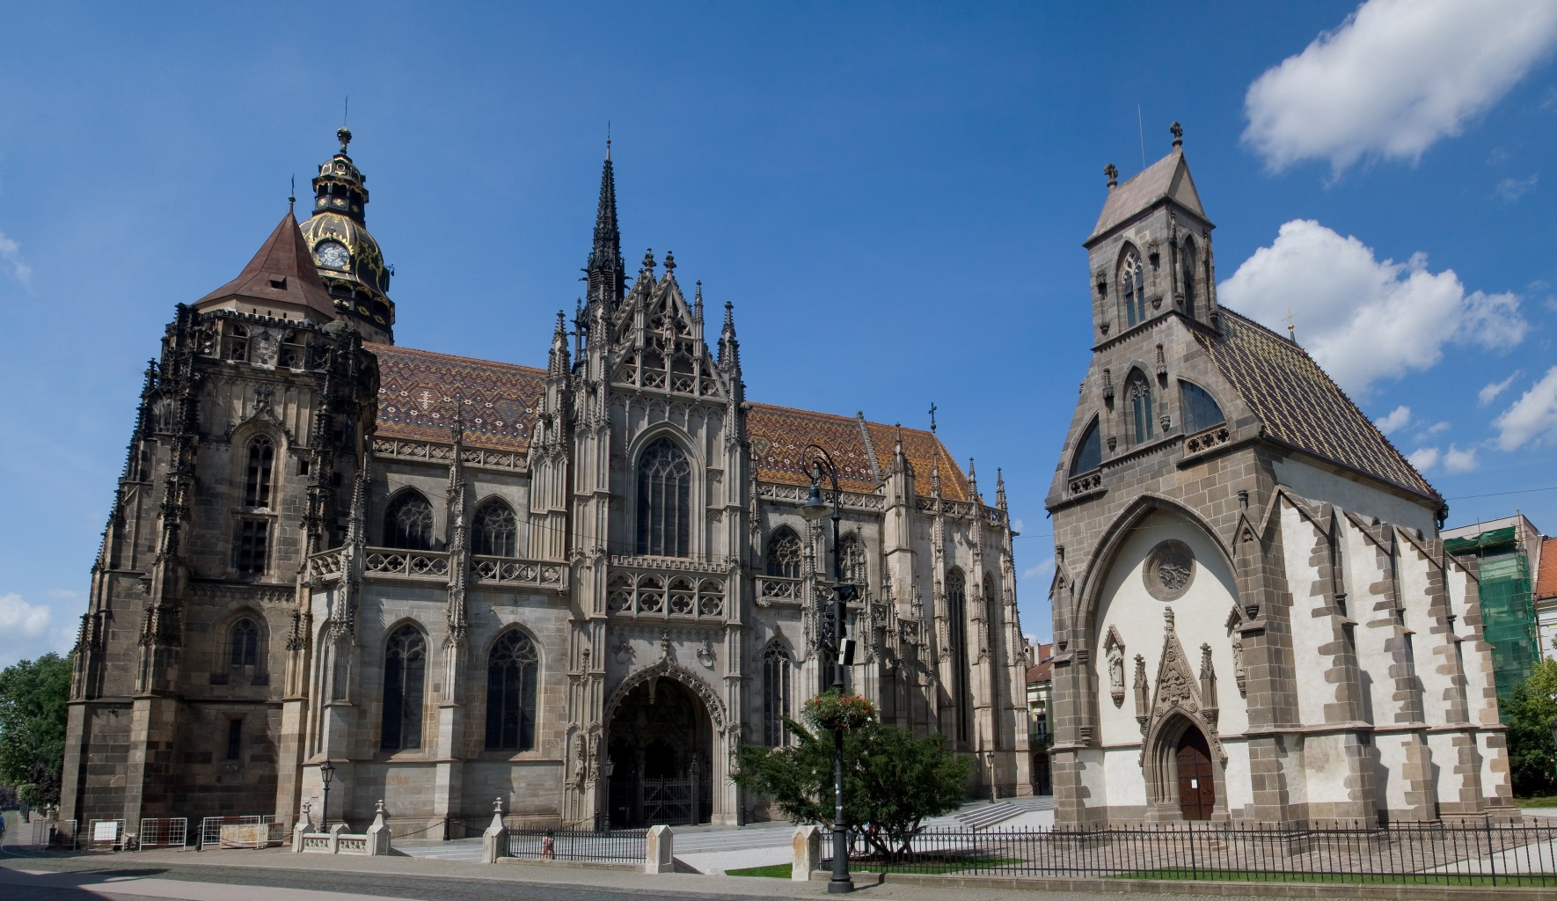
Cities
Košice, Žilina, Nitra, Prešov, Banská Bystrica, Martin

Slide 11
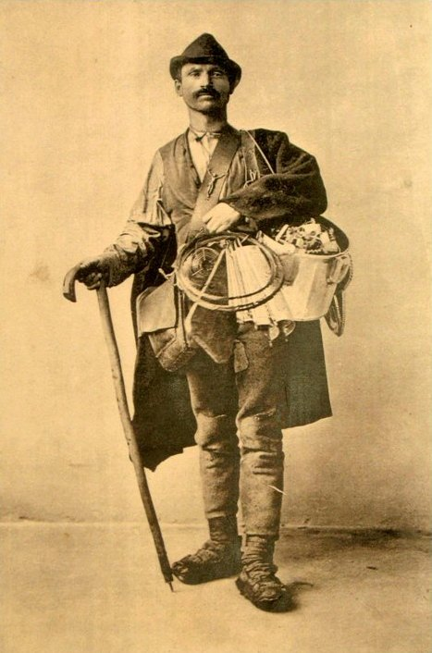
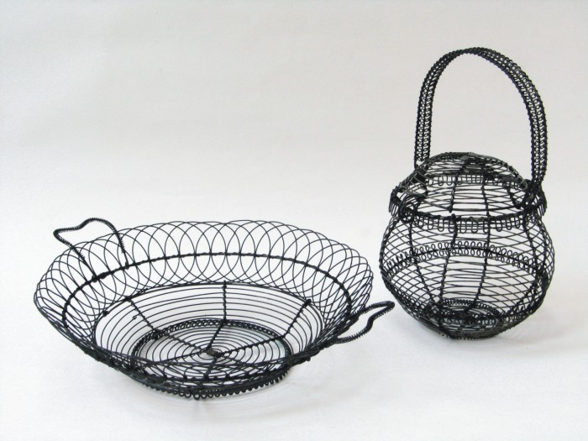
Folk tradition
Tinkery in Slovakia has almost 300 years of tradition.
Tinkery
The roots of the tinkery craft come from [northern Slovakia's] Kysuce region.

Slide 12
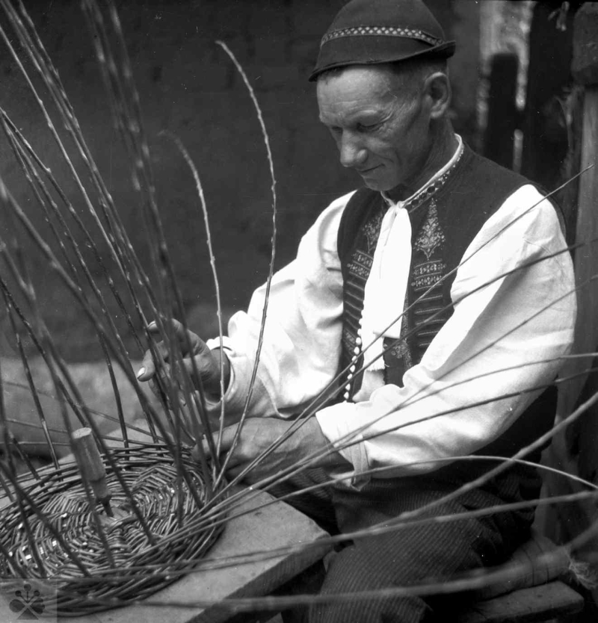
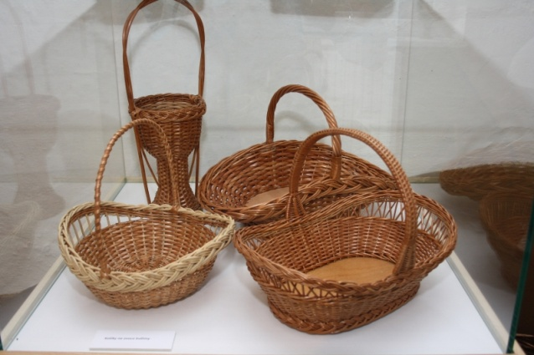
Basket weawing
Basket weaving is one of the oldest handcrafts in Slovakia. Using mostly natural materials various vessels for storing or carrying food and goods were produced.

Slide 13
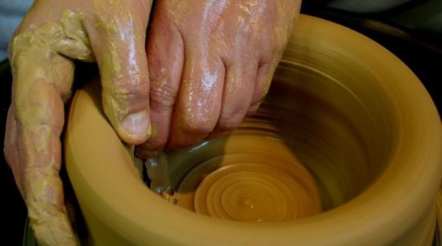
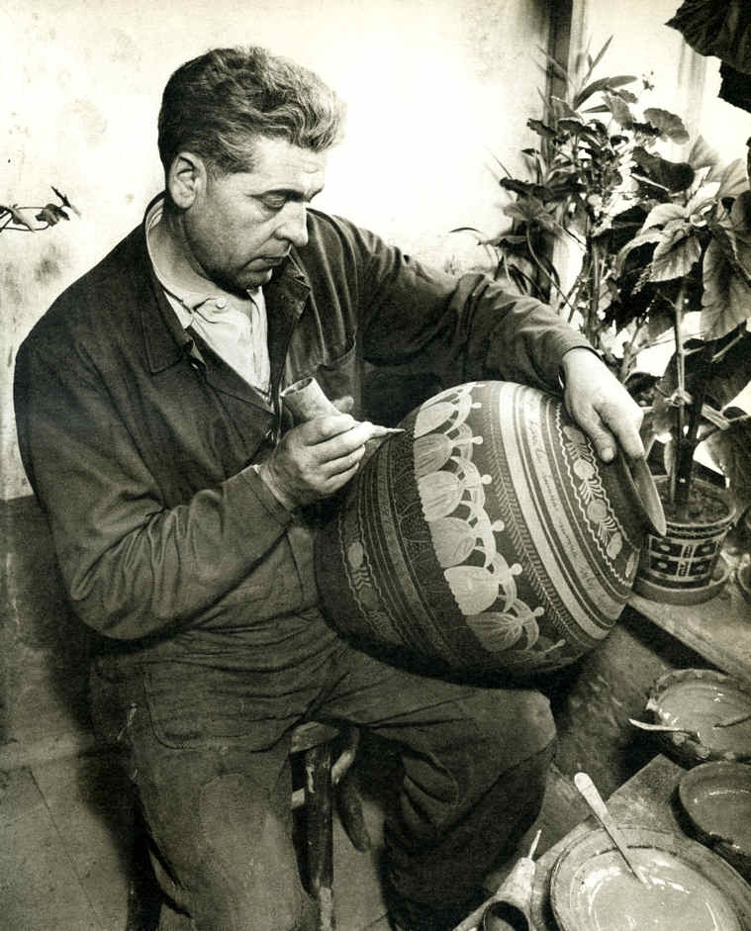
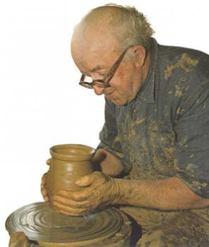
Pottery
The first pottery guild on the territory of Slovakia came into existence in Bardejov in 1475. The development of pottery was connected with practical needs of the countryside households for various kinds of dishes.

Slide 14
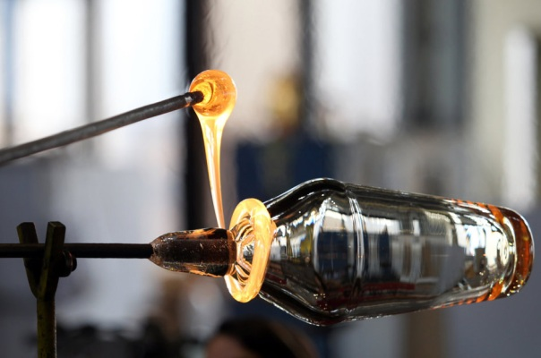
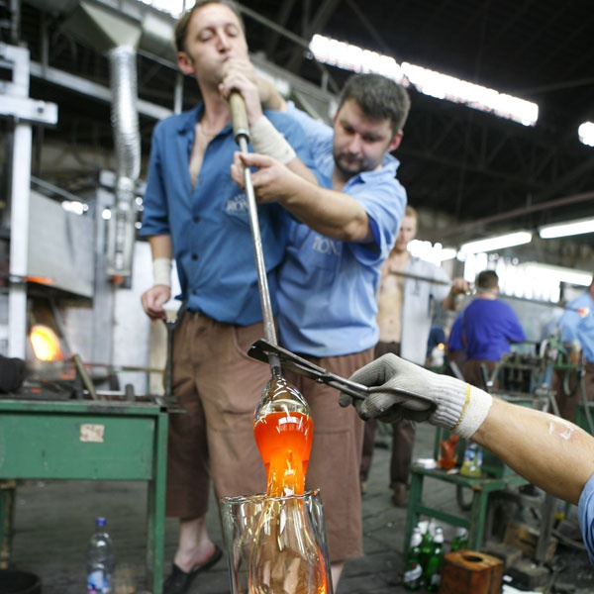
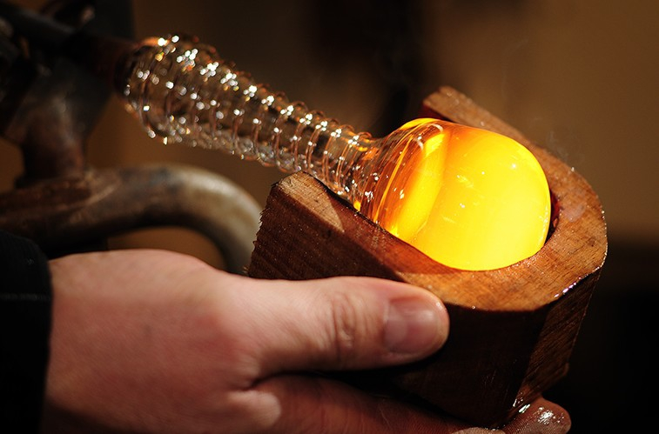
Glass making
Glass making is an ancient industry, which is engaged in manufacturing glass and glass objects. The first known glass guild was established in Kremnica.

Slide 15
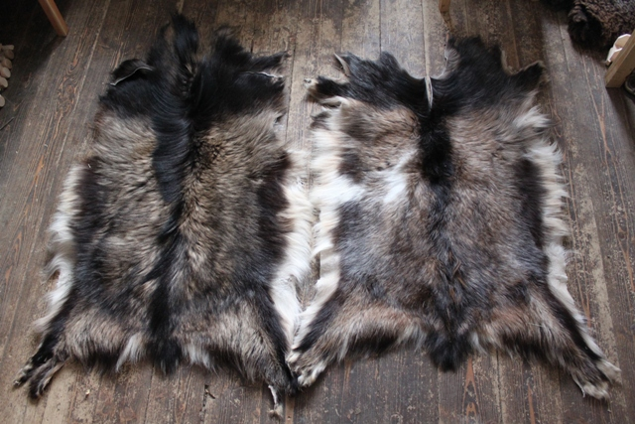
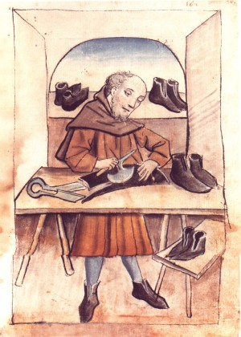
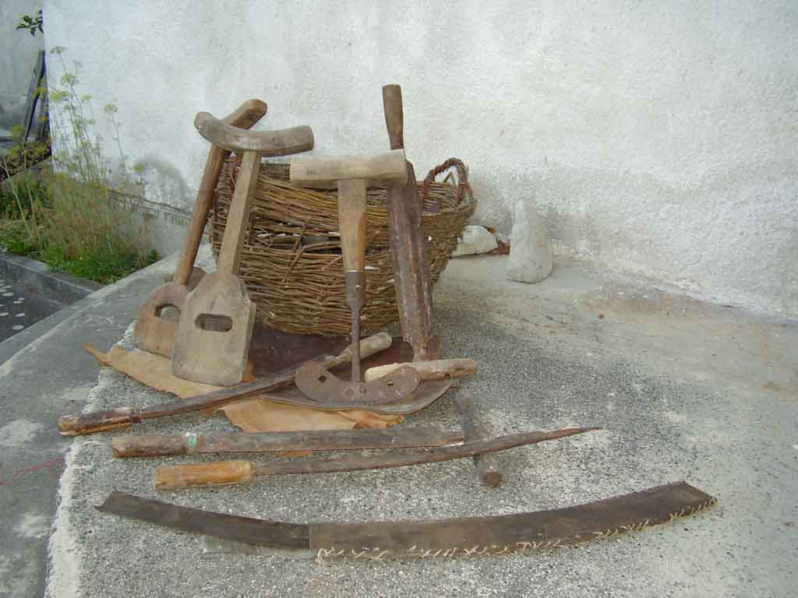
Tannery
Tanning is the process of treating skins of animals to produce leather.

Slide 16
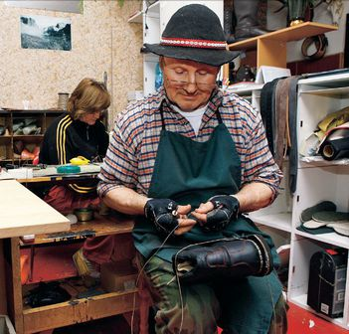
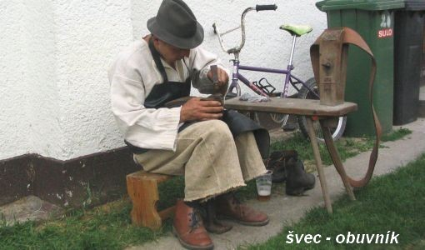
Shoe making
Shoe makers repaired but also produced new shoes.

Slide 17
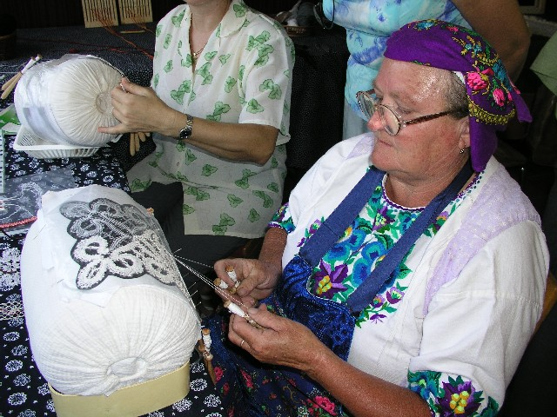
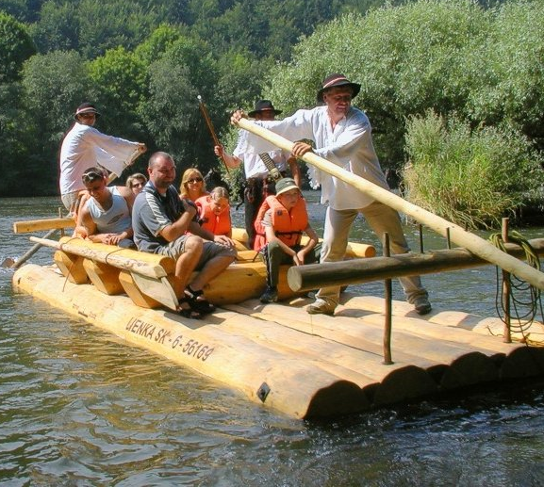
Lace making
Rafting

Slide 18
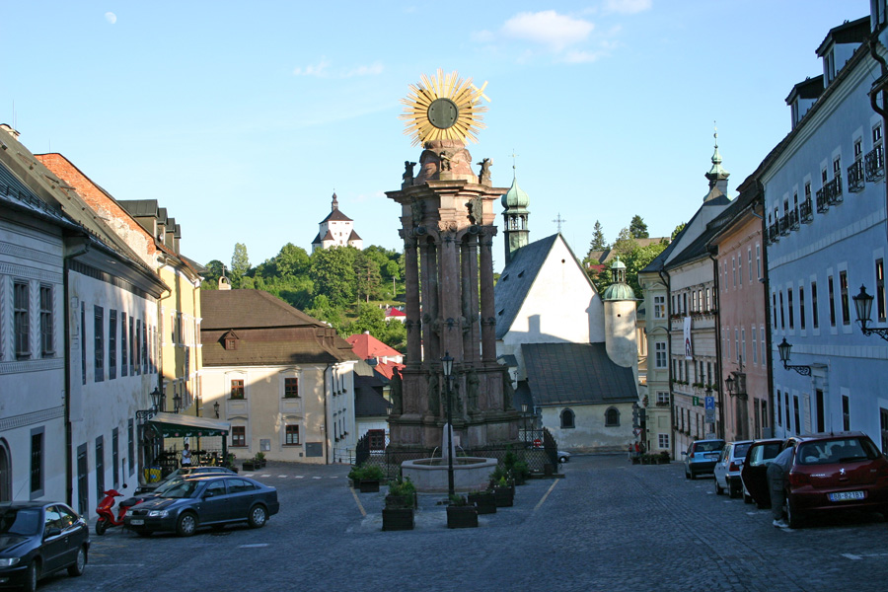
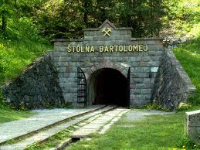
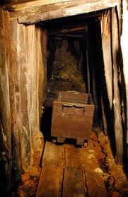
UNESCO
Banská Štiavnica
It is one of the most important centers of former mining, mining science, technology and education in Europe.

Slide 19
Spiš castle
Spiš castle is a unique historic residential unit. Spiš castle dates from the 12th century and is one of the largest in Central Europe.

Slide 20
Vlkolínec
More than 40 original, inhabited wooden houses is an example of the former Slovak mountain village.
The village rustic wooden belfry from 1770

Slide 21
Caves
Dobšinská Ice Cave, Ochtinská Aragonite Cave

Slide 22
Bardejov
The longitudinal central square is the most important part of the city. There you can see important urban architectural, artistic, historical and cultural structures and values​​.

Slide 23
Beech forests of Carpathians

Slide 24
Wooden churches in central and eastern Slovakia
Tvrdošín
Hervartov

Slide 25
Levoča
It is located in eastern Slovakia in Spiš region The town has a historic center with a well preserved town wall, a Renaissance church with the highest wooden altar in World, carved by Master Paul of Levoča, and many other Renaissance buildings.

Slide 26
Pictures of Slovakia

Slide 27
Thank you for your attention

