Slide 1
The Ugly Duckling
Slovakia
Erasmus +

Slide 2
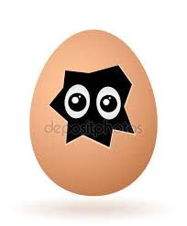
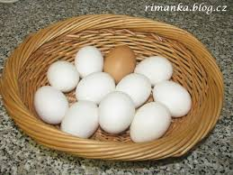
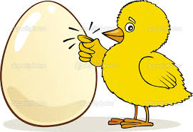
Mother and father duck were looking at their eggs
But only one egg was different
It was brown and has not been cracked yet

Slide 3
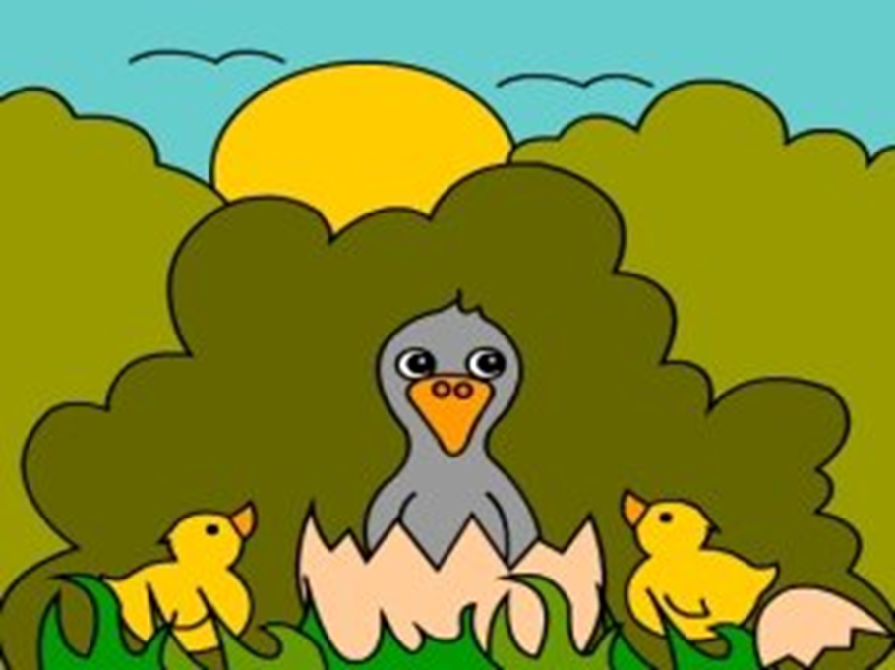
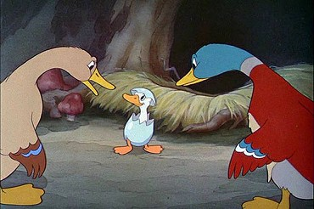
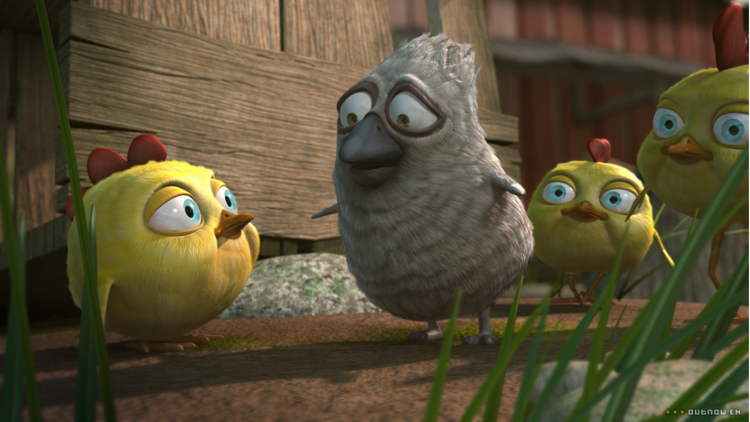
Suddenly it cracks and grey, ugly duckling appears
Oh how ugly is it – say other ducklings
It was very sad and started to cry
And they named him Ugly duckling
Nobody likes him

Slide 4
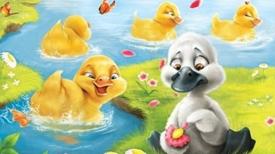
And every day it cried and every one makes him sad
One day it he could not stay longer
He had to go far away
He was walking and walking

Slide 5
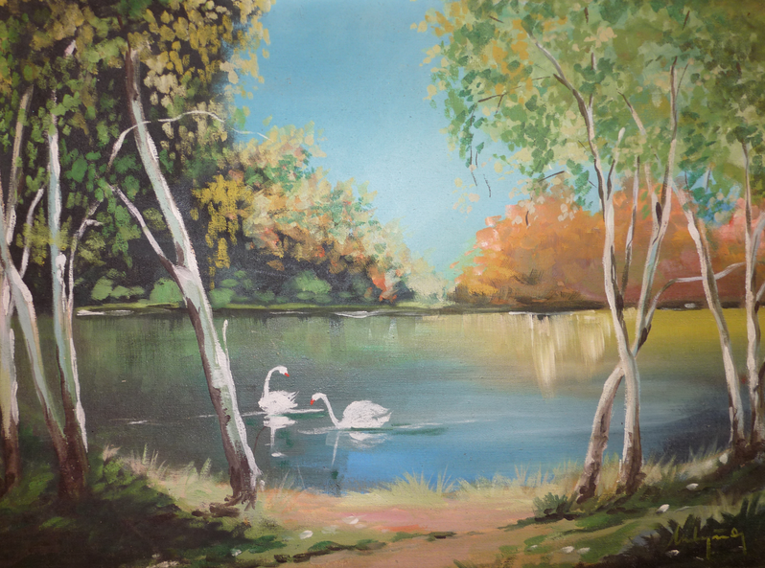
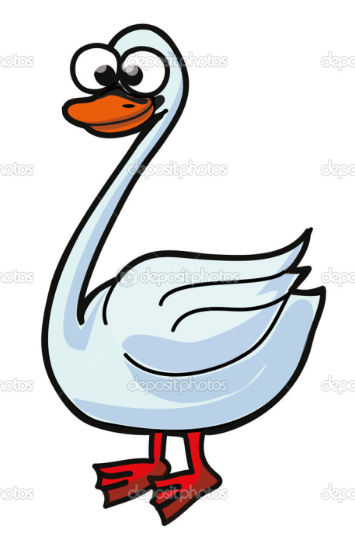
He came to the lake and he saw big white birds
There were swans
If I was like them, nobody would make me cry
Swans were flying and he wanted to be like them

Slide 6
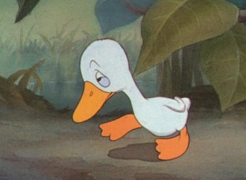
It started to rain and weather changed
Autumn came
Duckling walked and was looking for new home

Slide 7
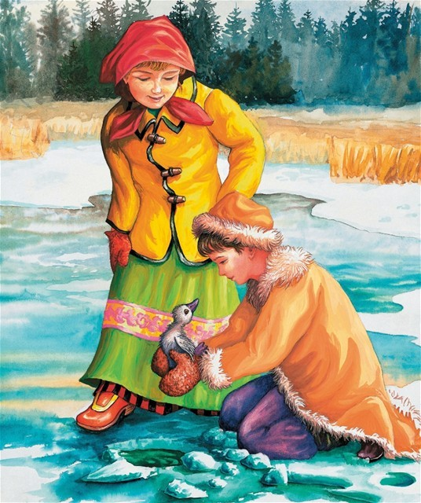
Children found him
Brought him to home but cat wanted eat him
He had to leave in the winter
He was cold and nobody likes him

Slide 8
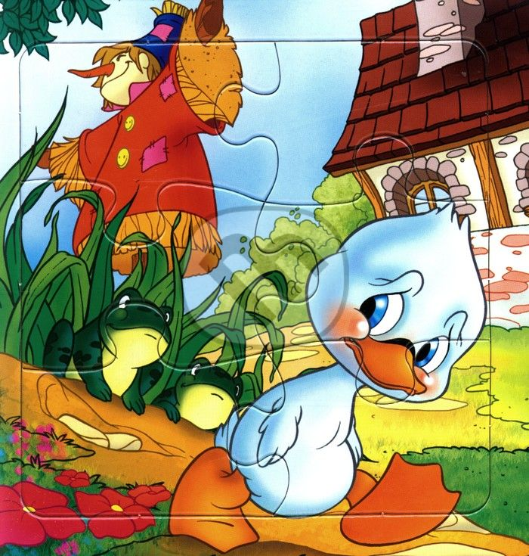
He had to leave
The spring came
Grass grown up and trees became green
He went alone far away

Slide 9
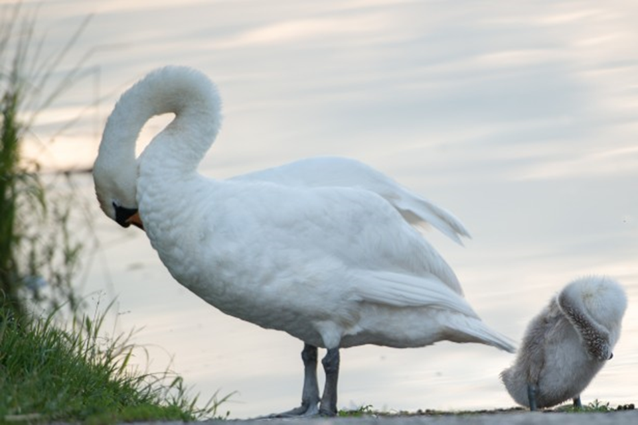
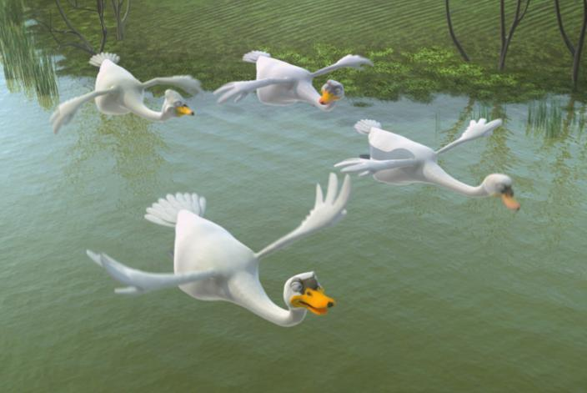
In spring swans came to the pond
You are so beautiful.
Come to us – said swans to duckling
He was sad and looked into the pond

Slide 10
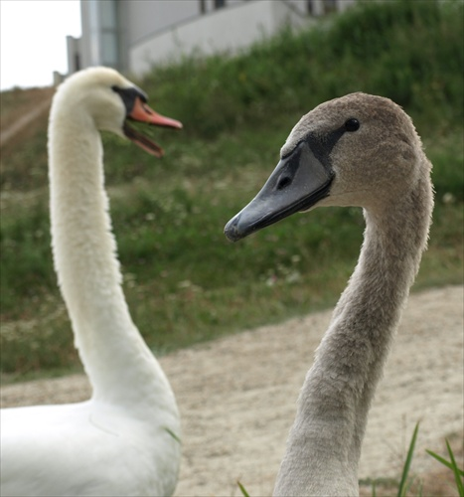
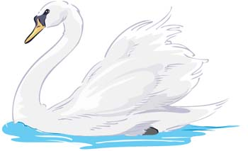
But he saw his beatiful face
He became a big swan
He was the most beautiful swan and eaveryone liked him
Happy end of ugly duckling

Slide 11
Thank you for your atention

