Slide 2
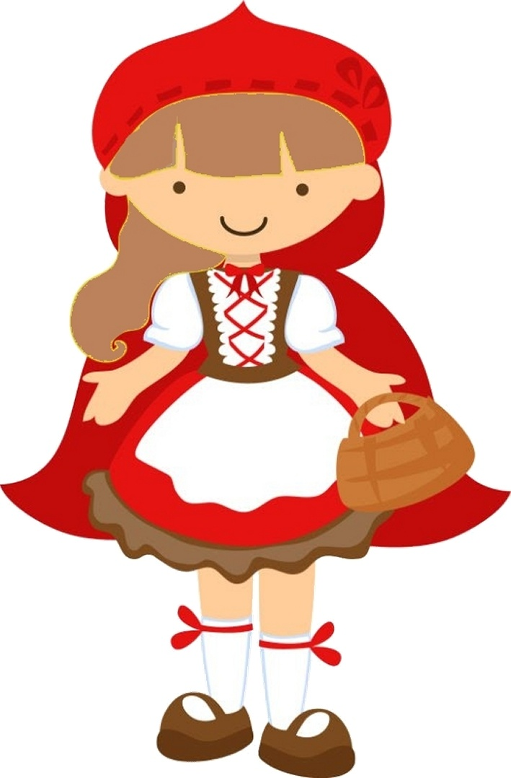
Little Red Riding Hood
Červená čiapočka
The Slovak Republic

Slide 3
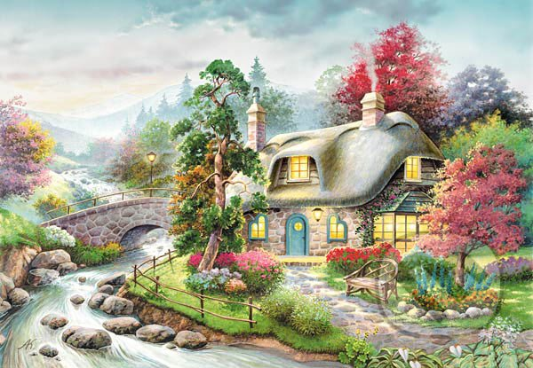
Once upon a time there lived a girl called Little Red Riding Hood.
Together with her mother, she often visited her grandmother, who lived in small cottage out in the woods

Slide 4
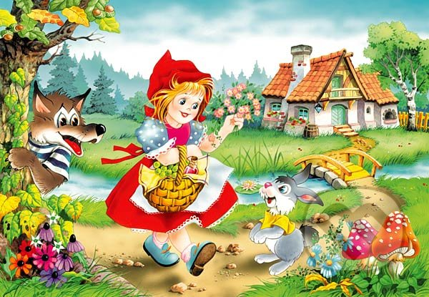
One day her mother was very busy, so the girl had to go to her grandmother alone.
The old woman was ill and it was necessary to bring her medicine, bread and fruits.

Slide 5
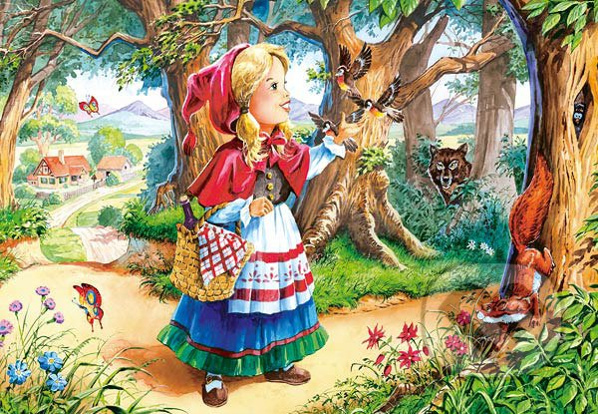
Mother warned her daughter not to leave the path.
But the girl decided to bring to her sick grandmother a bouguet od flowers, and picking them here and there she was going further and further into the woods.

Slide 6
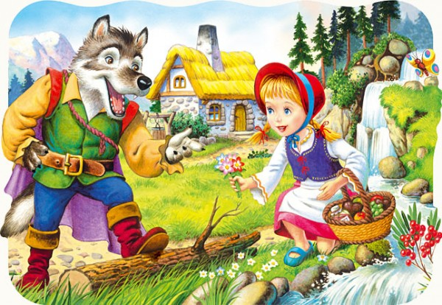
She did not notice that someone was watching her.
He greeted the girl politely and she told him about her ill grandmother and showed him the way to her house.
The wolf ran, taking the shortest path, ate the old woman.

Slide 7
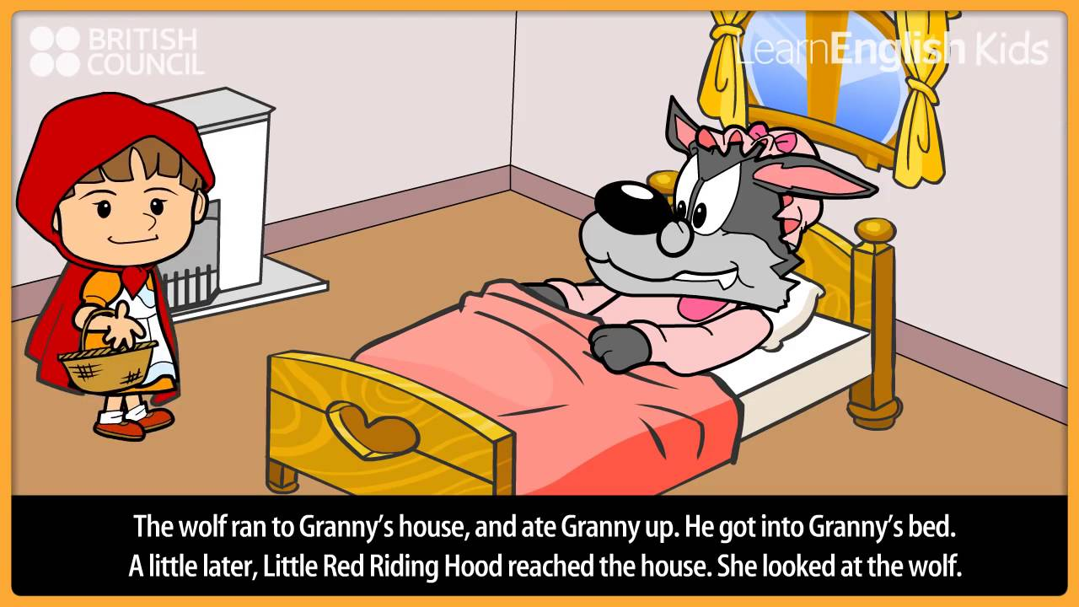
The girl was surprised when she entered the cottage and she saw her grandmother.

Slide 8
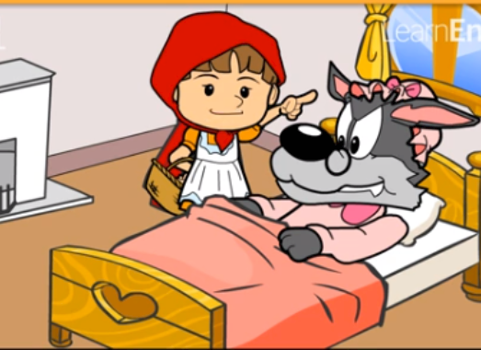
Red Riding Hood is an grandma asked:“Why you have big ears?“
Grandma answered:“I could hear you better.“

Slide 9
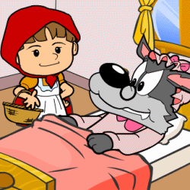
Red Riding Hood asked again:“And why you have such big eyes.“
Gradma answered:“Because I could see you better.“

Slide 10
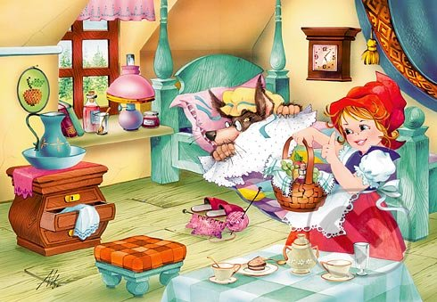
“And why you have so big teeth?“ Asked Red Riding Hood.
Grandma answered:“I could to better eat you!“

Slide 11
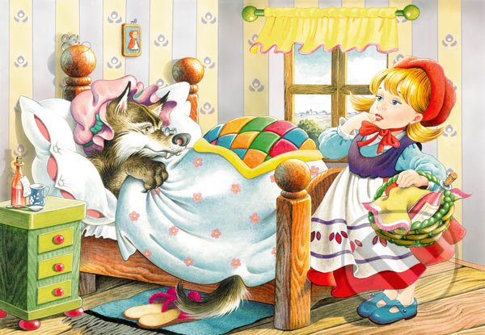
And wolf jumped out of the bed and he want eat Red Riding Hood.
She run out of the grandmothers house.
She run to a forester.

Slide 12
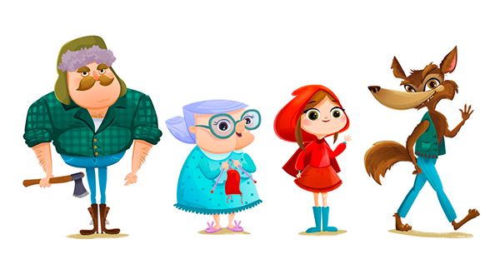
The forester killed the wolf and set the grandmother free.
The grandmother and Red Riding Hood thanked the brave forester for the rescue.
They lived happily forever and ever.

Slide 13
The end

